Slide 1

Getting Started with Python
https://github.com/ryan-leung/PHYS4650_Python_Tutorial/
Ryan Leung (PhD in Astrophysics)
Python Tutorial for PHYS 4650
8th Feb, 2017

Slide 2
Please try to set-up your python in your computer /open Jupyter
While listening, you may goto Page 14
https://goo.gl/8OkRrs

Slide 3
Learning Outcomes
Choose your own text-editor.
Get a working python for your OS.
Use python in ipython notebook.
Define different data structures.
Make a loop with for and while.
Defining functions.
Reading files and plotting graphs.
And practising with examples.
https://goo.gl/8OkRrs

Slide 4
Part 1
Installing/Running Python

Slide 5
Why python ?
Python and Programing
https://goo.gl/8OkRrs

Slide 6

What is python language?
High-level programming language.
Object-oriented, interpreted, interactive.
Easy write, easy read.
Dynamic variables & memory management.

Slide 7
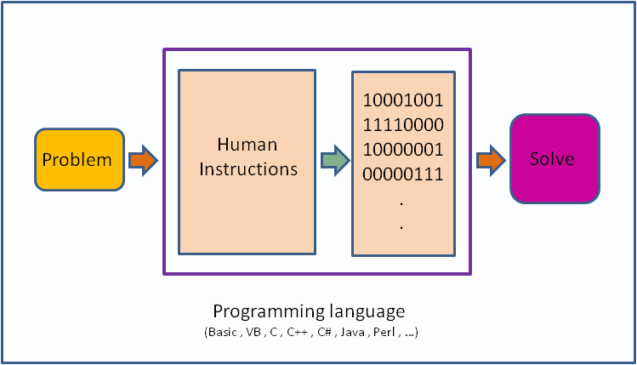
Programming basic
Sequences of instructions that tell the computer to solve your problem.
Like cooking,
A program is a receipt.
You prepare raw food, seasoning, etc. (Input)
If you follow the receipt, you will get a good food (hopefully).

Slide 8
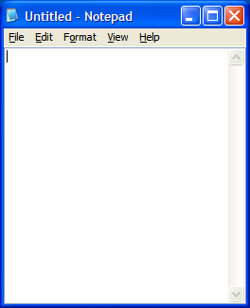
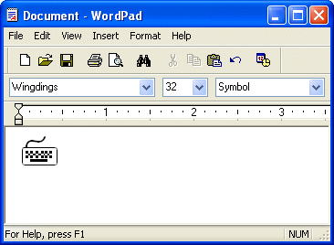
Writing a program
First, get yourself a text editor.
Avoid using old-school editor:

Slide 9
Writing a program in command line (mac / linux)
Vim
nano

Slide 10
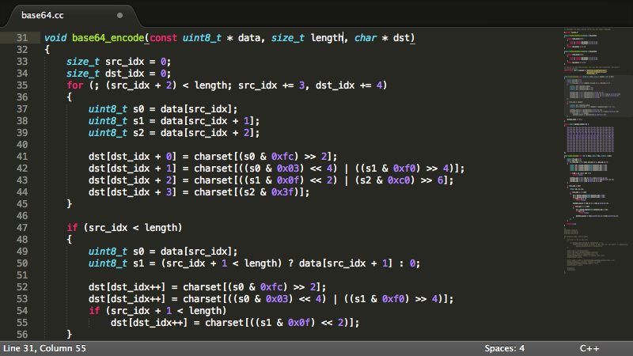
Writing a program
(GUI editor)
For windows:
Notepad++ Sublime Text
Notepad++: https://notepad-plus-plus.org/
Sublime Text: https://www.sublimetext.com/

Slide 11
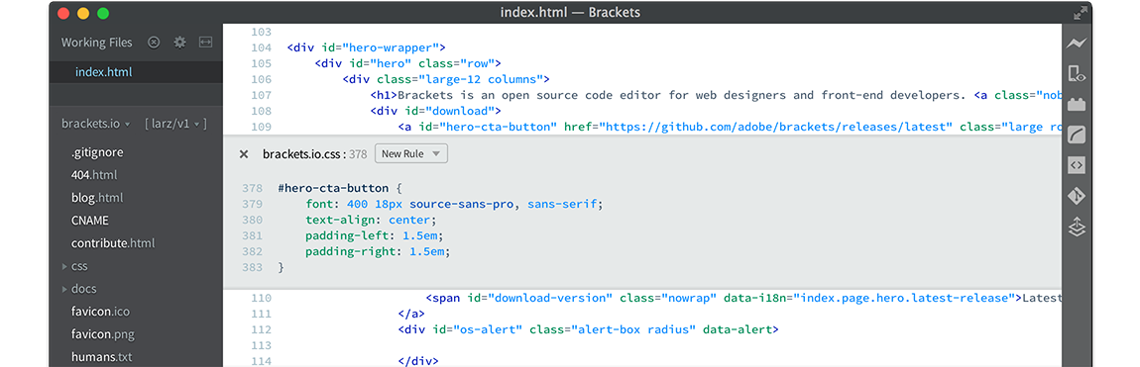
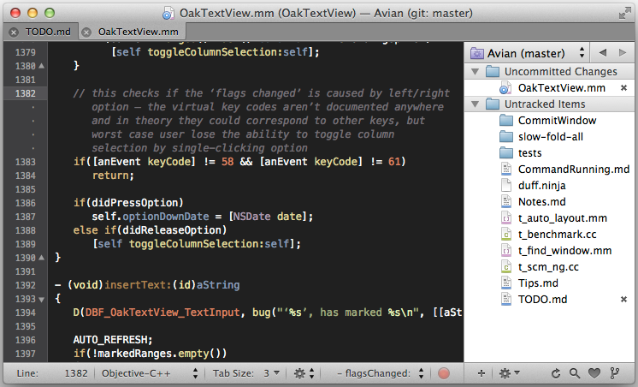
Writing a program
(GUI editor)
For mac:
Brackets
Textmate
Sublime Text
Brackets: http://brackets.io/
Textmate: http://macromates.com/

Slide 12
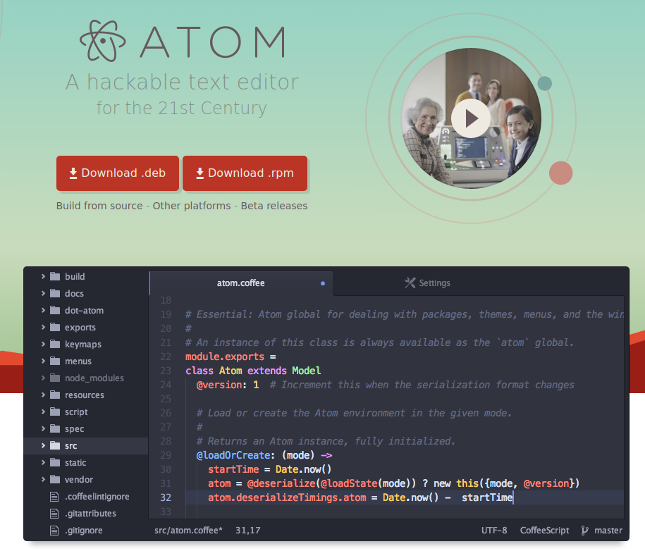
Writing a program
(GUI editor)
For linux:
gedit
Geany
atom
Sublime Text

Slide 13
Writing a program
Second, think what you are going to do
Define some initial constant as “variables”
Write some “operations” ==> final products.
But problems usually comes out,
and that’s call “bugs”.

Slide 14
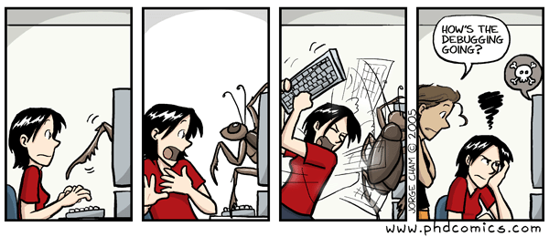
Bug is hard to kill!
Coding and debugging is a tough task
Spend less time debugging, Code more!
Lots of packages written in Python for speed deployment!

Slide 15
How can I get python?
Install python and get it works

Slide 16
Python distribution
Anaconda / Miniconda (Win, mac, Linux)
https://www.continuum.io/downloads
http://conda.pydata.org/miniconda.html
Official Site (Win, mac, Linux)
https://www.python.org/downloads/
Linux: pre-installed, or get it from repository:
Fedora: sudo dnf install python
Ubuntu: sudo apt-get install python
Mac: macports / homebrew
If you have macports on your mac, you can follow this instruction in macports_installation.md

Slide 17
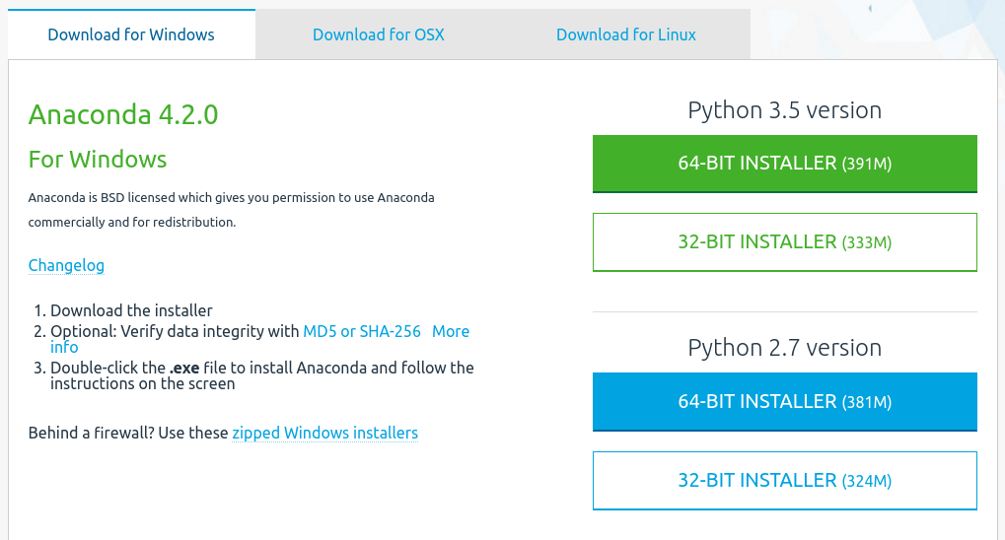
Get Anaconda

Slide 18
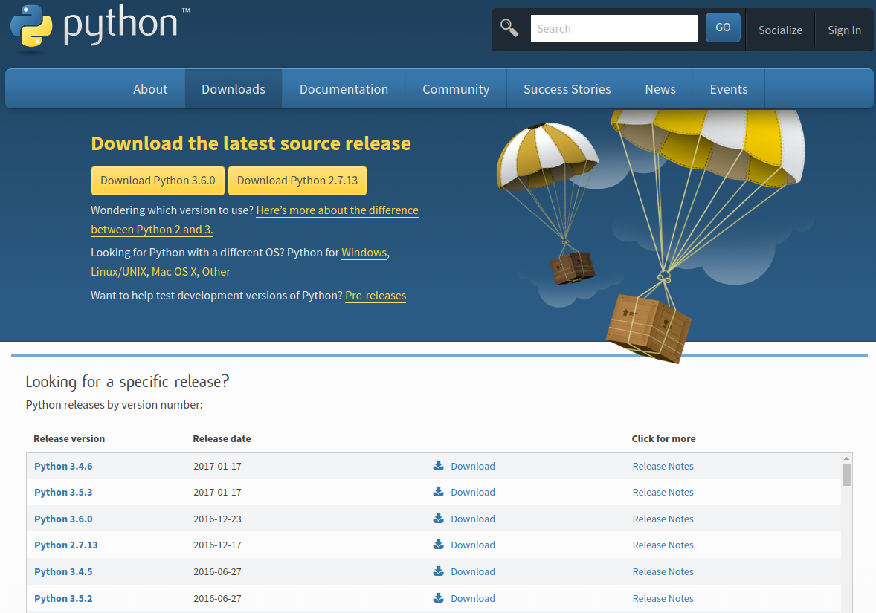
From official site

Slide 19
Python version, 2 vs 3
Python 2 vs Python 3:
Python 2 still has a huge number of users.
Officially, they suggest people to use python 3
Python 3 is the future, it reduces nasty way to code.
But there stills a lot of well-written package for python 2.
So, learn both is the best option, you can use any of it, but keep it consistent.
Learn to use “__future__” package in python2.

Slide 20
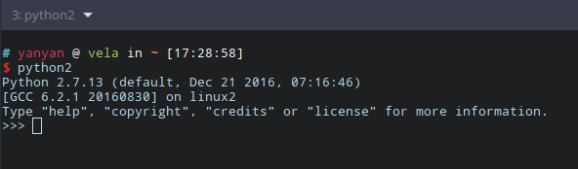
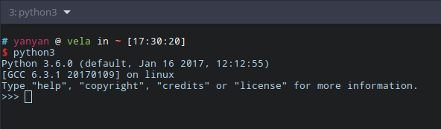
Check your python version
You can always check the python version by running its interpreter.
We use python 2 in this workshop.

Slide 21
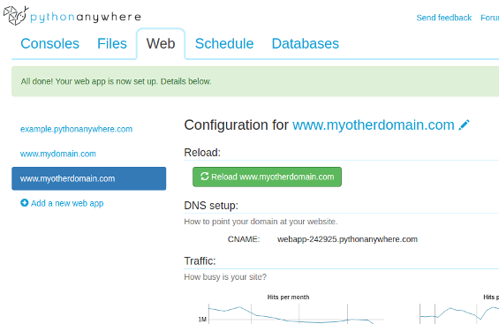
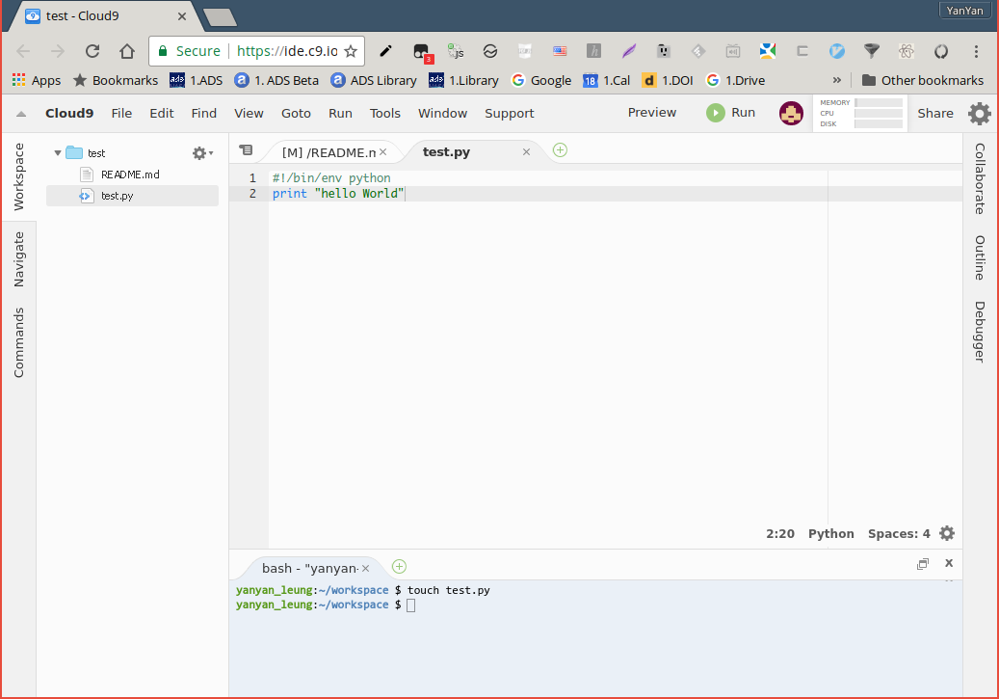
Python in the cloud
https://www.pythonanywhere.com/
https://c9.io/

Slide 22
Very subtle things
about package!
How to add packages to python?

Slide 23


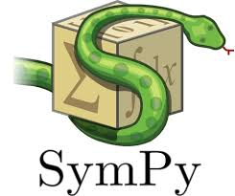
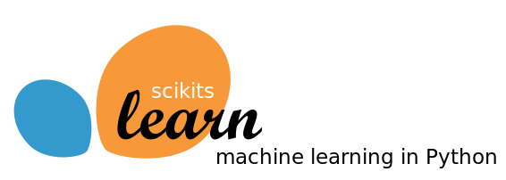
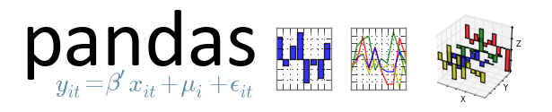
Symbolic /numerical / statistical / machine learning
For symbolic
sympy
For numerical
numpy
scipy
For statistical and machine learning
scikit-learn
pandas

Slide 24




Python plotting / visualising
matplotlib
all-round, major plotting in python
aplpy
FITS image plotting in high quality
yt
large data / volumetric data visualising
bokeh
interactive plots in html & javascript

Slide 25
Install package (Anaconda)
To search/install packages, use “conda”
Command:
conda search xxxxxx
conda install xxxxxx
Other commands:
http://conda.pydata.org/docs/_downloads/conda-cheatsheet.pdf

Slide 26
Install package (pip)
To search/install packages, use “pip”
Package list: https://pypi.python.org/pypi
Command:
pip search xxxxxx
pip install xxxxxx
Useful Commands: install Install packages. uninstall Uninstall packages. freeze Output installed packages in requirements format. list List installed packages. show Show information about installed packages. search Search PyPI for packages. zip Zip individual packages. unzip Unzip individual packages. bundle Create pybundles. help Show help for commands.

Slide 27
I don’t have pip :(
https://pip.pypa.io/en/stable/installing/
Linux user:
https://packaging.python.org/install_requirements_linux/#installing-pip-setuptools-wheel-with-linux-package-managers
Fedora
Fedora 21:
Python 2:
sudo yum upgrade python-setuptools sudo yum install python-pip python-wheel
Python 3:
sudo yum install python3 python3-wheel
Fedora 22:
Python 2:
sudo dnf upgrade python-setuptools sudo dnf install python-pip python-wheel
Python 3:
sudo dnf install python3 python3-wheel

Slide 28
Finally, it’s time to
run a python script
How to run your scripts

Slide 29
Part 2
Start Python

Slide 30
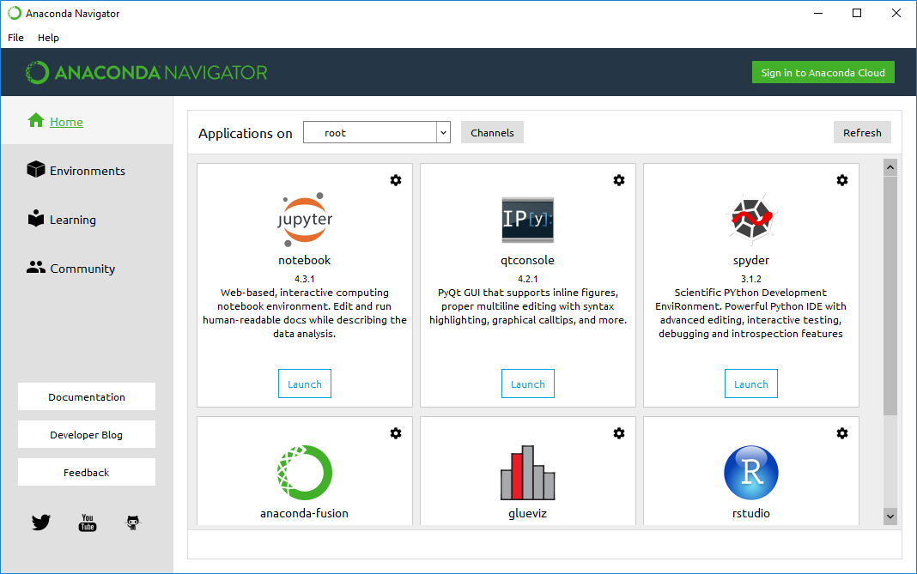
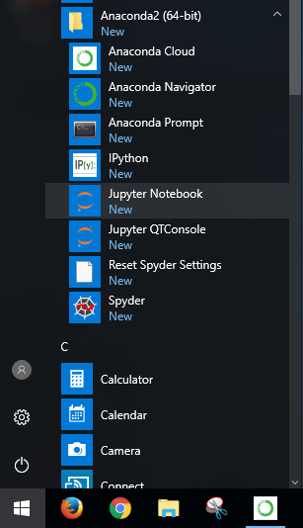
Open jupyter in Windows

Slide 31
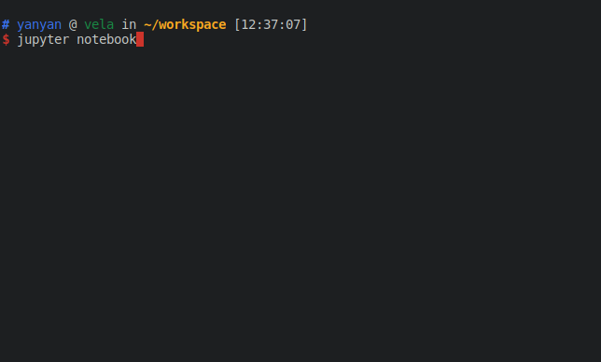
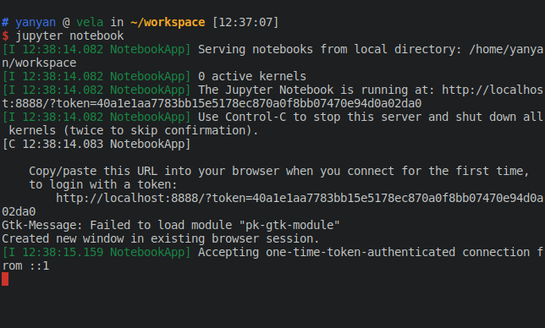
Open jupyter in linux / mac

Slide 32
Running a python script
You can always check the python version by running its interpreter.
We use python 2 in this workshop.
A common shebang line used for the Python interpreter is as follows:
#!/usr/bin/env python
You must then make the script executable, using the following command:
chmod +x xxxxxxxxx.py

Slide 33
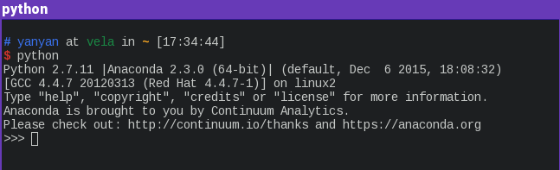
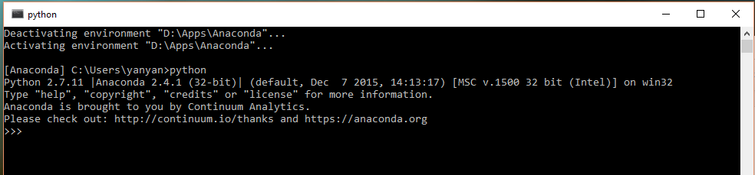
Python interpreter
For Linux / OSX, type “python” in terminal.
For windows, open “Anaconda” folder in Start menu.

Slide 34

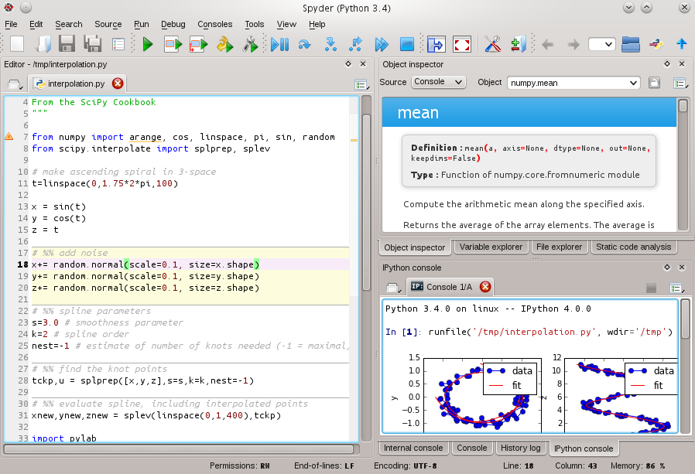
Spyder IDE
Like Matlab

Slide 35
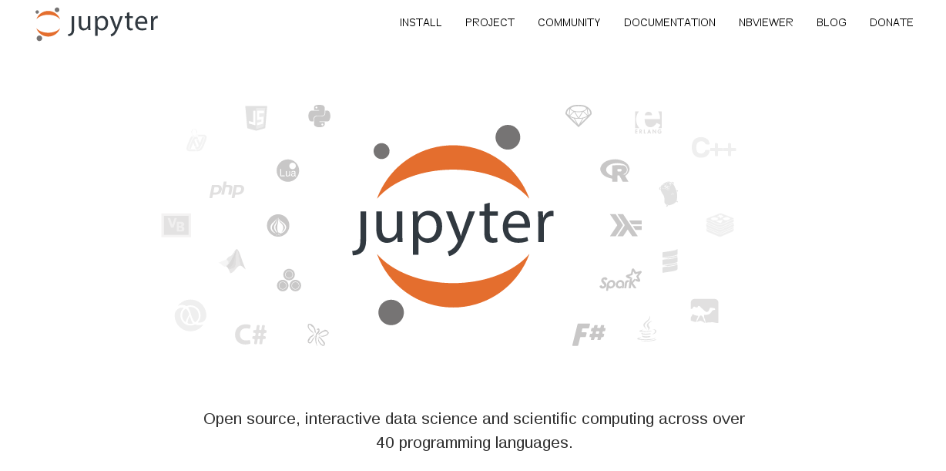
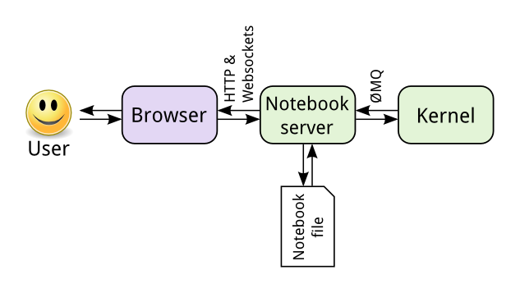
ipython / jupyter
Like Maple /
Mathematica!
For more interaction and gun, we use ipython to run our python code. ipython is old name, new name is call jupyter.

Slide 36
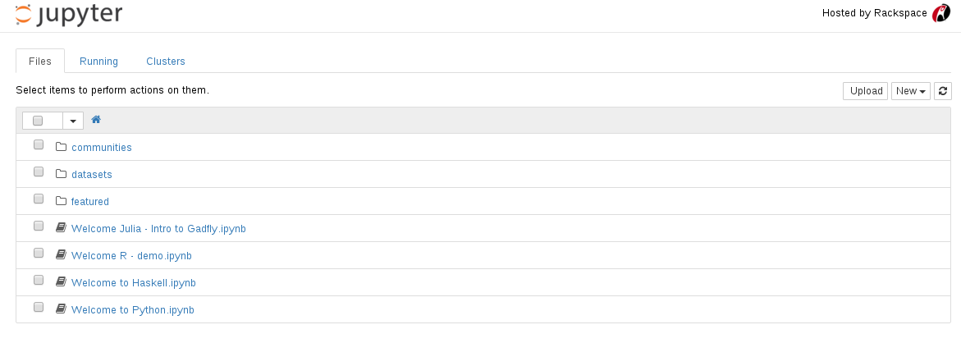
Launch ipython for testing purpose
Lazy? https://try.jupyter.org/
But missing some packages! Better run your program in your own computer
New “notebook”
Open saved “notebook”

Slide 37
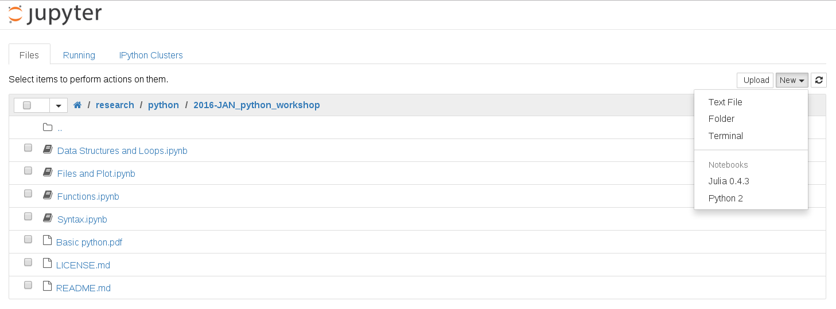
Launch ipython in your computer
In command prompt/terminal, type
ipython notebook
Go to http://localhost:8888/ in browser

Slide 38
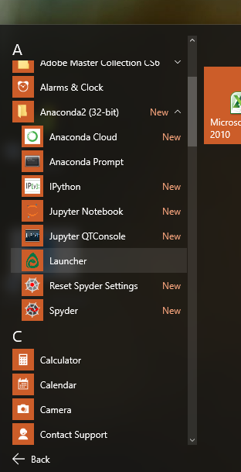
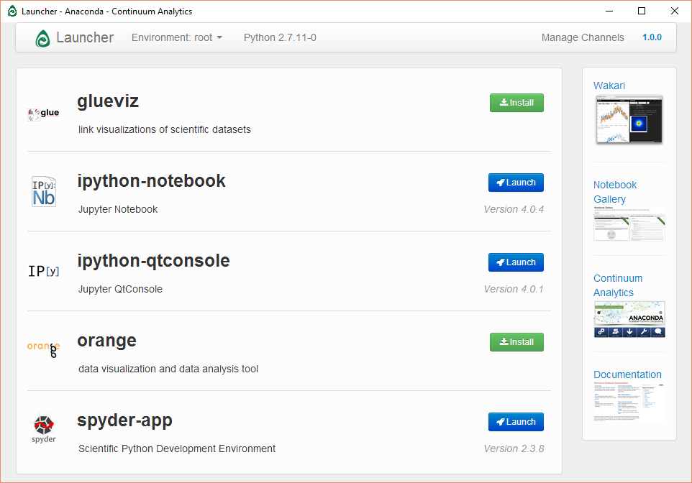
Launch ipython in your computer
If you have Anaconda GUI / using Windows, you can also launch here:

Slide 39
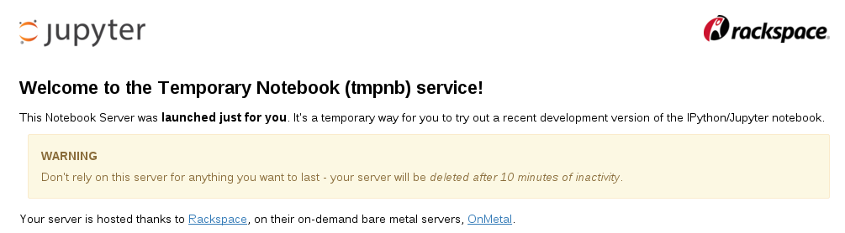
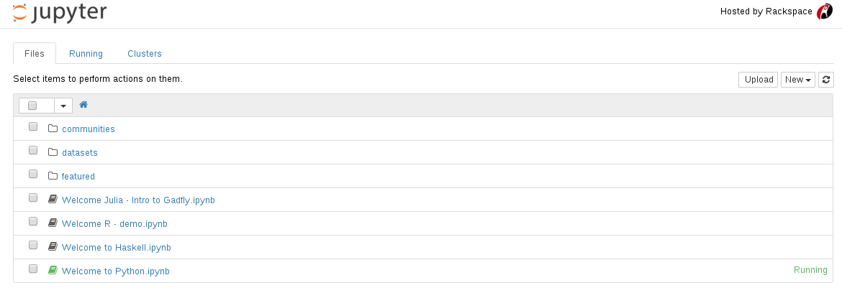
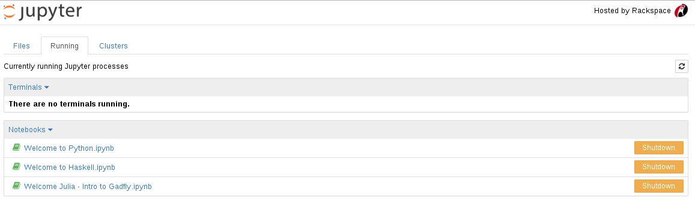
Opened/running notebook
Shutdown button
All running notebook

Slide 40
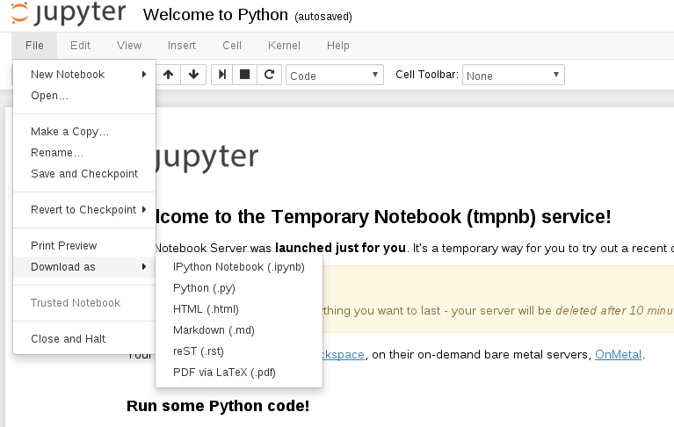
ipython (save/download notebook)
Save “notebook”
Download in different format
Stop the notebook

Slide 41
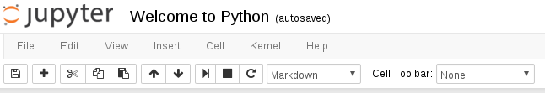
Notes on using ipython/jupyter
Something goes wrong?
Stop the kernel
Stop the current cell operation
To be safe, make sure you open each notebook document in only one tab.
Data will lost if the kernel is stopped.
You can close the browser tab safely after the notebook say “notebook saved”. It will run in background

Slide 42
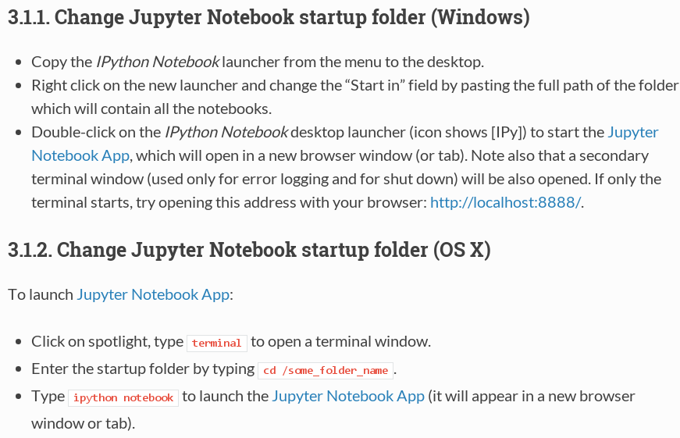
Notes on using ipython/jupyter

Slide 43
Part 3
Basic Python

Slide 44
Syntax
CH1 Syntax.ipynb

Slide 45
2. Data Structures and Loops
CH2 Data Structures and Loops.ipynb

Slide 46
3. Functions
CH3 Functions.ipynb

Slide 47
4. Files operation
CH4 File operations.ipynb

Slide 48
5. Plots with matplotlib
CH5 Plots.ipynb

Slide 49
6. Advanced plotting
CH6 Advanced Plot.ipynb

Slide 50

Python in astronomy
Until ~2012 python astronomy modules were scattered.
Several core modules are now unified under astropy:
astropy.wcs (World coordinate system (WCS) supported by PyWCS.)
astropy.io.fits (FITS files support supported by PyFITS.)
astropy.coordinates (Celestial coordinate and time transformations.)
astropy.units (Unit and physical quantity conversions, physical constants specific to astronomy.)

Slide 51
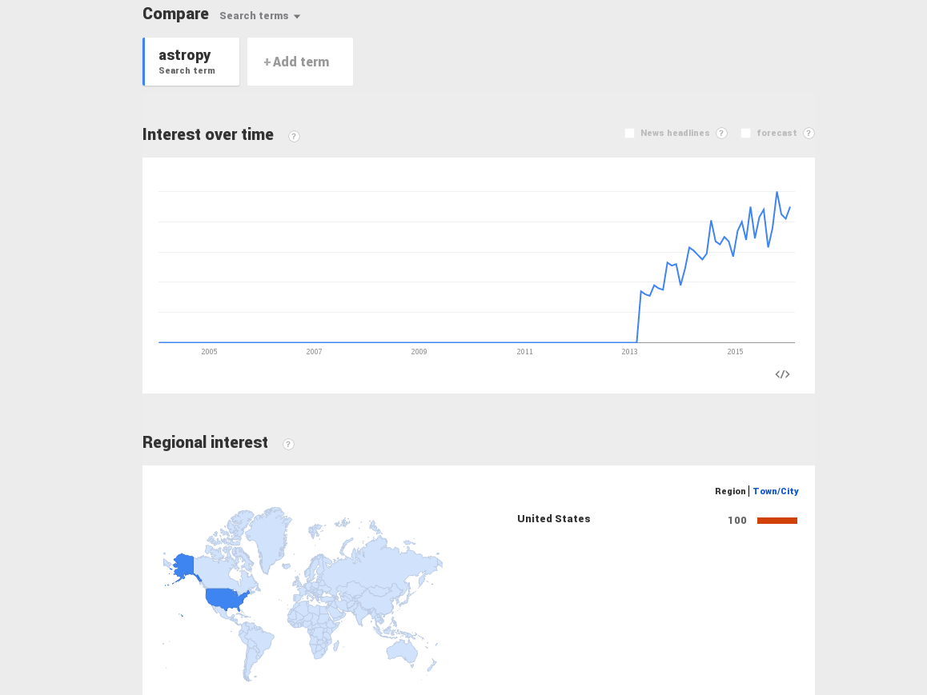

Slide 52
7. Tools for astronomy
Astropy - Load fits.ipynb
APLpy - Fits image & colour map.ipynb
APLpy - Cass A in 3 colours.ipynb

Slide 53
Need more performance?
Any language apart from python and have a great performance?

Slide 54
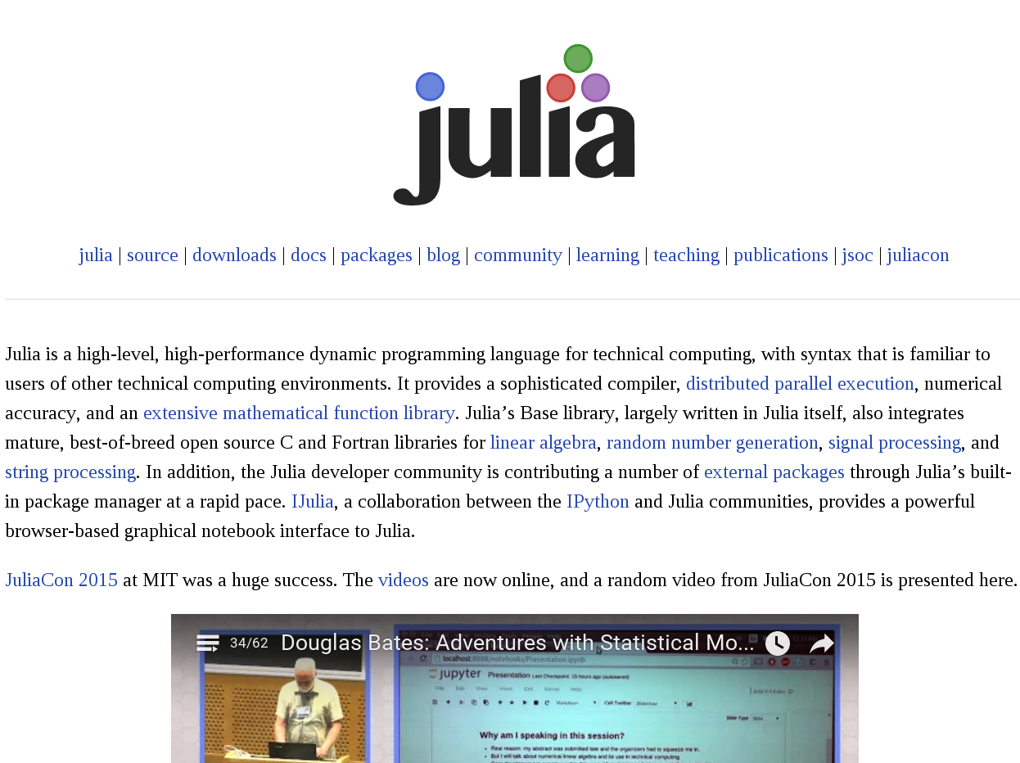

Slide 55
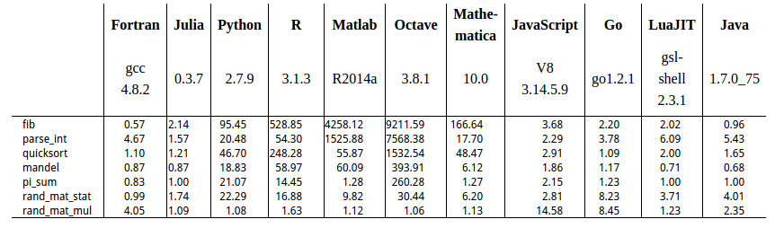
Some basic features in julia
Syntax similarities: python,MATLAB and C
Utilize matplotlib for plotting, clever and sweet
Performance compatible to C & Java
Ijulia and Jupyter

Slide 56
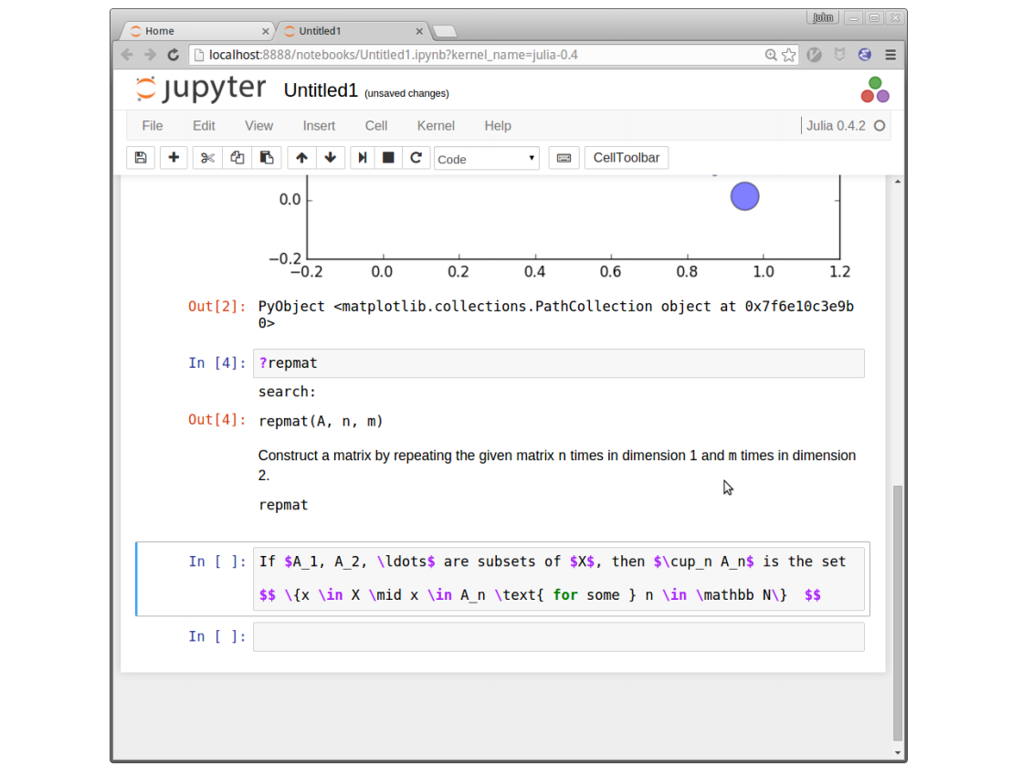

Slide 57
That's all
You can stay here for practising, I have collected some programming tasks for you

Slide 58
Remember to
practise at home
Questions are obtained from https://projecteuler.net/

Slide 59
Some sample data sets are included
There are many datasets under the “datasets” folder
Load any one of them and try to plot them out :)
Remember you can download the file by:
import urllib urllib.urlretrieve("URL", "yourfilename")
Or you create a text file and put all the data into it.

